Slide 1
Key Club Meeting 2
September 14th, 2016

Slide 2
Agenda
Call Meeting to Order
Pledge to US Flag
Key Club Pledge
Moment of Silence
Announcements/ Upcoming Events
Recognition/Introduction of Guest
Speaker
Adjournment of Meeting

Slide 3
Key Club Pledge
I pledge, on my honor, to uphold the Objects of Key Club International; to build my home, school and community; to serve my nation and God; and combat all forces which tend to undermine these institutions.

Slide 4
Requirements
25 service hours are required for the year:
15 KC Hours
10 Non- KC Hours
* You can have more than 15 KC hours to reach the minimum of 25*
1 Key Club sponsored event is required per semester.
*Babysitting does NOT count
You will need to complete 100 hours beginning from freshman year to earn the graduation cord. (This in itself is not a requirement for Key Club, but something that you should try to achieve anyways!)
You also need to show up for one meeting a month.

Slide 5
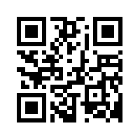
How to Sign Up
Go to this link and fill out the google form:
goo.gl/WtrL94

Slide 6
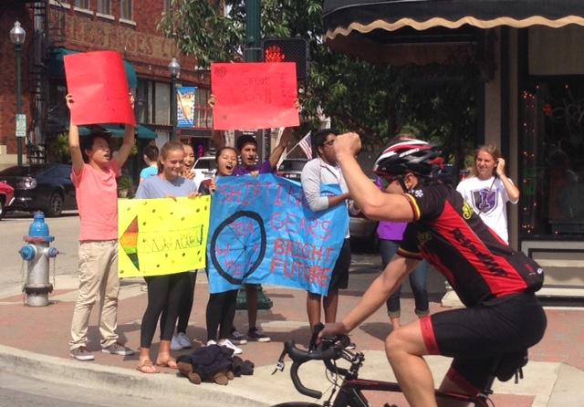
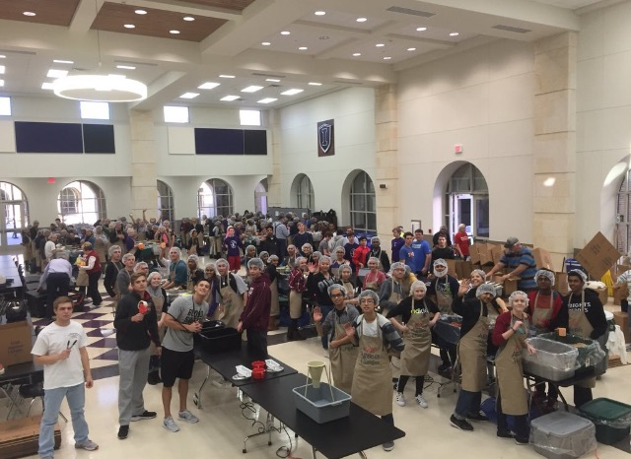
Save The Dates
Membership Form Deadline: 9/14
Kids Against Hunger: 9/28
Make A Wish Foundation Posters: 10/4 & 10/6
Make A Wish Foundation Event: 10/8
Gary Burns Fun Run & 5K: 10/29

Slide 7
Next Meeting
Key Club always meets every 2nd and 4th Wednesdays of the month.
We will not have a meeting on the 28th due to the Kids Against Hunger Event.

Slide 8
GUEST SPEAKER
PLEASE WELCOME OUR GUEST SPEAKER:
MS. SHARON BRIAN

Slide 10
Connect with Key Club
Remind101: Text @ihsk to 81010
If this number doesn’t work, try texting @ihske to 972-776-2366 instead.
Twitter: Follow @ihskey_club for more updates!
Facebook: Independence HS Key Club
Email: ihsknightskeyclub@gmail.com if you have any questions.
Website: www.ihsknightskeyclub.weebly.com

