Slide 1
Key Club Meeting 1
August 31, 2016

Slide 2
Icebreaker
Objective: Form a group in which all 12 months of birthdays are represented
First team to form it wins!!

Slide 3
Key Club Pledge
I pledge, on my honor, to uphold the Objects of Key Club International; to build my home, school and community; to serve my nation and God; and combat all forces which tend to undermine these institutions.

Slide 4
Introduction
Advisors- Mrs. Hippler and Mrs. Miller
President- Anjika Bhalla
Vice President- Satya Boddu
Public Relations- Ankit Shah
Secretaries- Macy Shult & Melissa Wang
Editor- Keaton Hippler
Treasurer- Grace Zhou

Slide 5
What is Key Club?
Key Club is the oldest and largest student-led organization in the world!
Throughout the year we will find a variety of volunteering opportunities and help out in our community as much as we can. It also allows you to learn leadership skills by running meetings, planning projects and holding elected leadership positions at the club, district and international levels.
Key Club International is the high school organization sponsored by Kiwanis International. Kiwanis’ mission is to serve the children of the world.

Slide 6
Requirements
25 service hours are required for each semester:
15 KC Hours
10 Non- KC Hours
* You can have more than 15 KC hours to reach the minimum of 25*
1 Key Club sponsored event is required per semester.
*Babysitting does NOT count
You will need to complete 100 hours beginning from freshman year to earn the graduation cord. (This in itself is not a requirement for Key Club, but something that you should try to achieve anyways!)
You also need to show up for one meeting a month.

Slide 7
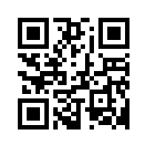
How to Sign Up
Go to this link and fill out the google form:
goo.gl/WtrL94

Slide 8
Service Shirts
Front
Back

Slide 9
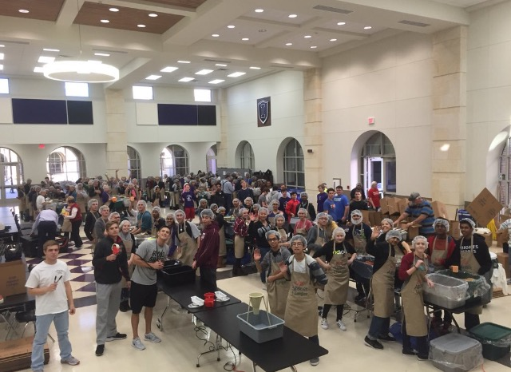
Save The Date: Kids Against Hunger Event
Where: Cafeteria
When: Wednesday, September 28th
*THIS IS KEY CLUB SPONSORED EVENT*
Kids Against Hunger is a event sponsored by Key Club where we package food in boxes to send to countries in famine. It’s a lot of fun, and a great way to meet new people and get your Key Club sponsored event for the semester!

Slide 10
Need extra hours?
If you would like to earn extra Key Club sponsored hours, write a 400 word article on one of the prompts listed on the next slide. For every article written (limit= 1 article per prompt per person per month) you will receive 30 minutes credit. If your article is chosen to be used in our local newsletter you will receive 30 more minutes of credit, and if it is featured in the Texas-Oklahoma District newsletter, you will receive an additional 30 minutes. (all articles submitted to me will be submitted to the district editor)

Slide 11
September Article Prompts
-What are you looking forward to most this school year and why?
-Why do you want to join Key Club?
All articles must be 400+ words to be awarded your hours. This is a monthly opportunity so remember to check the newsletter for new prompts each month! Please send all articles to: keaton.hippler.324@k12.friscoisd.org

Slide 12
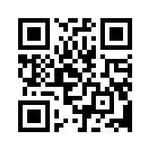
Mystery Member
Fill out this google form for our newsletter! Each month our newsletter will be sent out via Twitter (@ihskey_club), Facebook (Independence HS Key Club), and Remind 101 (Text @ihsk to 81010). Check the newsletter for upcoming projects, Member of the Month, and to guess the who the Mystery Member may be! If you think you know who it is, email our Club Editor at keaton.hippler.324@k12.friscoisd.org! The link for the Mystery Member Form is:

Slide 13
Next Meeting
Key Club always meets every other Wednesday.
Our next meeting will be September 14th. .

Slide 14
Connect with Key Club
Remind101: Text @ihsk to 81010
If this number doesn’t work, try texting @ihske to 972-776-2366 instead.
Twitter: Follow @ihskey_club for more updates!
Facebook: Independence HS Key Club
Email: ihsknightskeyclub@gmail.com if you have any questions.
Website: www.ihsknightskeyclub.weebly.com

